Slide 1

“What I struggled with in Photoshop” Photoshop in a few slides – for extreme beginners with easy steps to follow
By Sheetal Jena

Slide 2
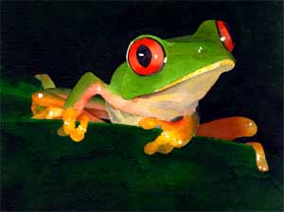
“How Does One Get Photoshop?”
Many people try and illegally download full versions, but for my class, since it was only a few weeks long, it was way easier to go on the Adobe website and use the free trial.
Just go on http://www.adobe.com/products/photoshop.html and press the button “Download Trial”

Slide 3

“How Does One Make a New File in Photoshop?”
As the artist in your group, you’re expected to fully understand how to use Photoshop. First, you have to open Photoshop.
If you want to make a new file, press Ctrl+N and give it a name. Adjust the size to be what you want it to be. For example, if you are designing a home screen for a tablet, adjust the width and height to the specific width and height for the tablet in pixels.
If you want to open an old file, press Ctrl+O.
My advice to you is, make a folder named “Photoshop” to save all of your photoshop files. Believe me, you’ll redo and do a lot.

Slide 4

Things you should know
A layer is an image on top of another image.
When you first use photoshop, you should unlock the first layer on the right side by double clicking on it and giving it a name. This gives you freedom to play around with your background.
You can also move layers and change their order. If one layer is under another, the lowest layer can be blocked.
It is handy to name your layers – by the time you finish with one file, you might have a ton and you will definitely be confused.

Slide 5
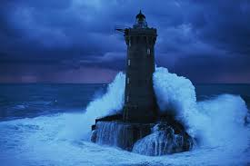
“How Does One Make A Button in Photoshop?”
Step 1) Use the rounded rectangle tool on the left hand side to make a rectangle. This is going to be the shape of your button. NOTE: The rounded rectangle is the most commonly used shape for a button. If you want a different shape, use all of the other shapes available by long pressing on the tool and going to the side drop off menu that pops up.
Step 2) You can change the color of the button by changing the fill color on the upper left.
Step 3) Double click on the layer of the rectangle in the layer panel. Blending Options will open. Use the bezel in order to make the button look more pressable and 3D.

Slide 6
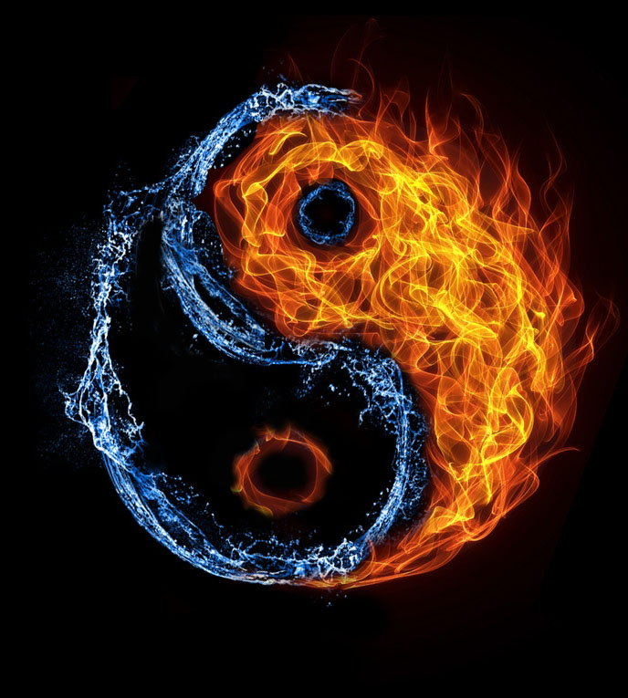
“How Does One Add Text To A Button?”
Step 4) To put text on the button, go to the text button on the left hand side labeled with an uppercase “T” and select it. Make a textbox – NOTE: do NOT just press on the button, make a rectangle with the text tool.
Step 5) Go to the layer panel on the right and just click on the text layer. This selects the layer. Next, go to the move tool on the left hand side – the icon is an arrow.
Step 6) click on the text and move it on top of the button and place it right where you want.

Slide 7
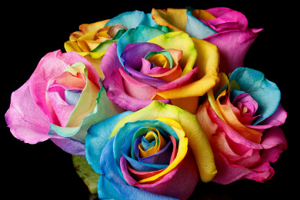
“How Does One Take Out a Piece of a Picture?”
Step 1) Find the picture in your files. TIP: If you want to take out a picture you see on a website, screenshot it so it saves as a picture. Drag the picture to Photoshop.
Step 2) Place the picture if it is not yet(press Enter key).
Step 3) Use the crop tool and crop the picture as much as you can to get rid of the background.
Step 4) Use the lasso tool (I prefer magnetic) to select the preferred space you want to isolate. TIP: If you want to be lazy, you can just the magic eraser tool – it won’t be perfect, but it’s pretty effective.
**If you have gaps inside of the selected area, use the eraser tool**

Slide 8

“How Does One Take Out a Piece of a Picture?” continued
Step 5) Press Ctrl+A
Step 6) Press Ctrl+C
Step 7) Press Ctrl+N
Step 8) Name the new file and press Ctrl+V

Slide 9
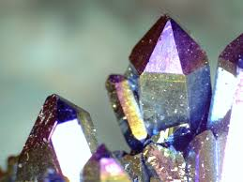
“How Does One Get A New Font for Photoshop?”
Step 1) Download the new font online.
Step 2) If it is a zipped folder, extract it.
Step 3) Go to the control panel and change the view by option from category to icons.
Step 4) Find the fonts folder. Drag the font file that was extracted to the font folder.
Step 5) This should be in your fonts in Photoshop now.

Slide 10
The End
Remember. You are in charge of making your app beautiful. Make sure you put as much effort as you can into making your app look good. Your part is just as important as the programmer and the project manager’s.
Goodluck!

